Slide 1
SWARM Statistical Way to forecast Aedes Range with a Mesh
Jeff Morgan
19morgan@cua.edu
http://www.swarmaedesmodel.com/
February 24, 2020

Slide 2
Agenda
Background/Method Description
Approach: Mesh/Fibonacci Weighting
Examples
Acknowledgements

Slide 3
Background/Model Description
Spread of Aedes Aegypti and Aedes Albopictus impacts Public Health
Gradual spread could be modeled as many iterations
Factors considered: Number of sites where Aedes Aegypti and Aedes Albopictus were Collected in the last two seasons
Surrounding counties could only increase probability
Weighting strategy based on Fibonacci numbers

Slide 4
Approach: Mesh
Approach: Probability of Aedes being collected in this year, in month x, in this county can be estimated from the probability of Aedes being collected as follows:
This year, month x-1. x-2, etc. (Not Available)
Last year, months x-1, x, x+1
Two years ago, month x
Surrounding Counties Probability (Only increased)

Slide 5
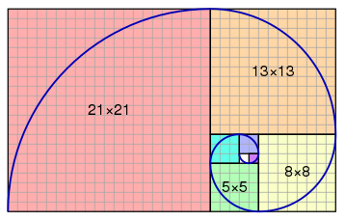
Weighting Strategy Based on Fibonacci Numbers
Governs a lot of things in nature; perhaps the spread of Aedes mosquitos
F_{n}/F_{n-1} → Golden Ratio Φ ≈ 1.618
1/Φ = Φ-1 ≈ 0.618 → Weight for “Surrounding Counties Score”
Φ² = 1-Φ ≈ 0.382 → Weight for “Just County Score”
F_{n-3}/(F_{n-3}+F_{n-2}+F_{n-1}+F_{n}) ≈ .106 → Weight for 24 months ago
F_{n-2}/(F_{n-3}+F_{n-2}+F_{n-1}+F_{n}) ≈ .171 → Weight for 13 months ago
F_{n-1}/(F_{n-3}+F_{n-2}+F_{n-1}+F_{n}) ≈ .276 → Weight for 11 months ago
F_{n}/(F_{n-3}+F_{n-2}+F_{n-1}+F_{n}) ≈ .447 → Weight for 12 months ago

Slide 6
Examples

Slide 7
Acknowledgements
People responsible for Aedes collections
CDC
Division of Vector-Borne Diseases
Michael Johansson, PhD
Mimi Huynh, MPH

